Slide 1

Framework for Airline Customer Satisfaction Analysis
Airlines that understand the pain points of their passengers and address them effectively have the opportunity to improve their reputation, customer retention, and overall service quality.We'll explore how to identify and mitigate service gaps across key travel touchpoints.
-by Apoorv Vaishampayan

Slide 2




The Challenge: Customer Dissatisfaction
1
Reduced Loyalty
2
Negative Reviews
3
Revenue Loss
4
Competitive Disadvantage
Customer dissatisfaction leads to a cascade of negative outcomes for airlines, impacting both reputation and bottom line.

Slide 3
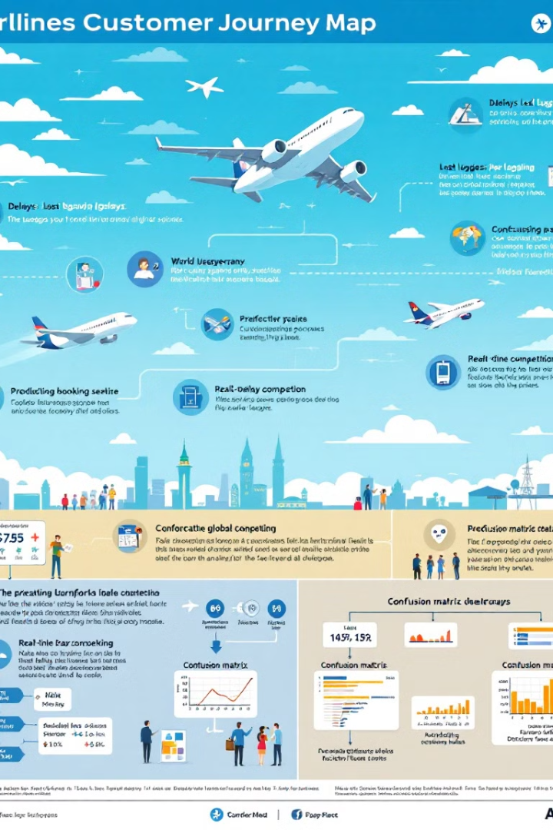
Key Issues in Airline Customer Experience
Service Gaps Across Touchpoints
Operational Inefficiencies
Unmet expectations in check-in, inflight service, and delay management create frustration.
Delays and poor communication contribute to a negative travel experience.
Rising Customer Expectations
Passengers demand personalized, seamless experiences that are challenging to deliver consistently.

Slide 4




Our Solution: Predictive and Actionable Framework
Predictive Modeling
Machine learning analyzes feedback and operational data to predict satisfaction.
Data-Driven Insights
Actionable recommendations based on key performance indicators (KPIs).
Real-Time Monitoring
Tracking system identifies and mitigates issues before they affect passengers.

Slide 5
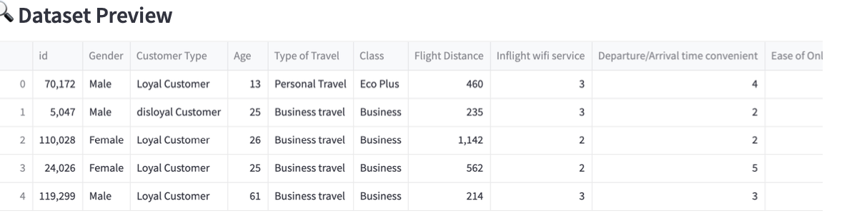
Dataset Features:
1. The dataset has 129881 rows and 24 attribute (columns).

Slide 6

Data Cleaning and Preprocessing
1
Handling Missing Values
Replaced missing delay values with 0 to ensure consistent analysis.
2
Dropping Irrelevant Columns
Removed 'id' column to focus on relevant features.
3
Encoding Categorical Variables
Converted categorical features to numerical using one-hot encoding.

Slide 7
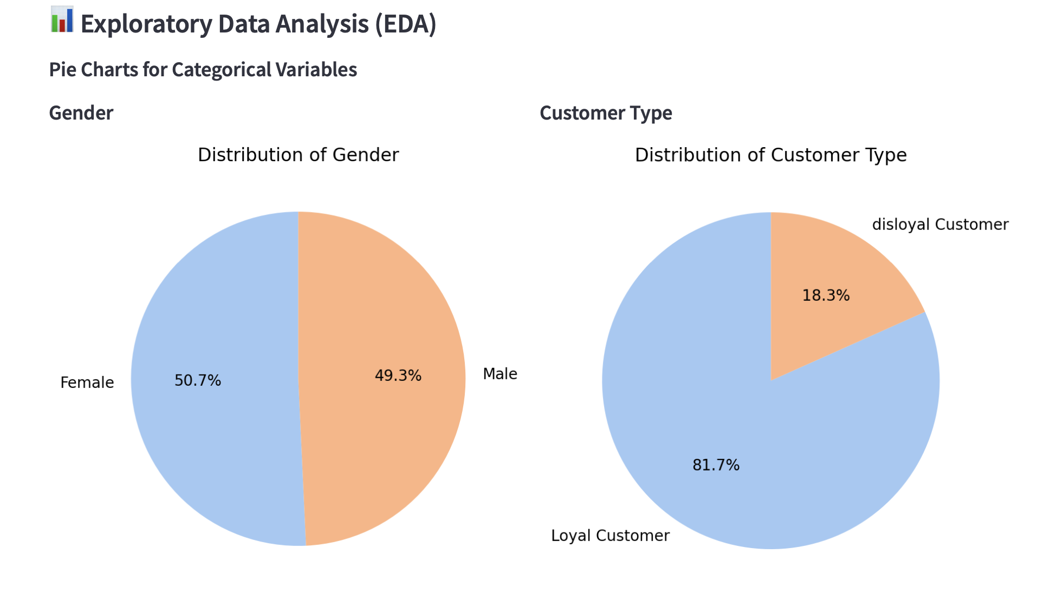
Exploratory Data Analysis:

Slide 8
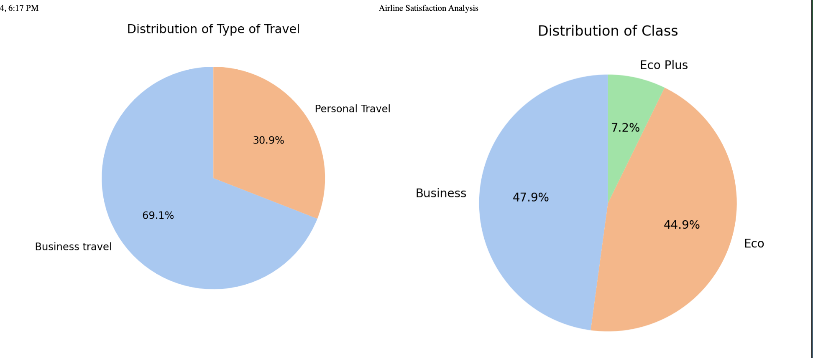
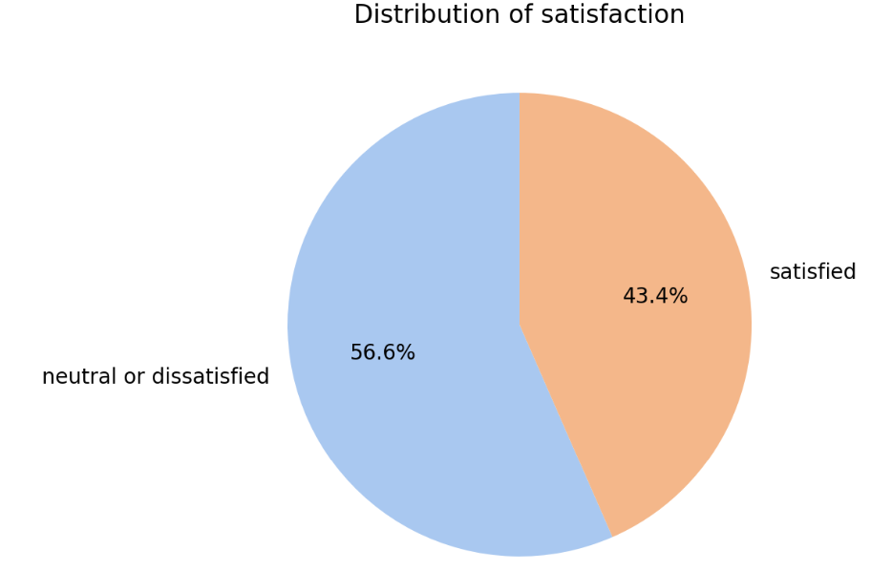
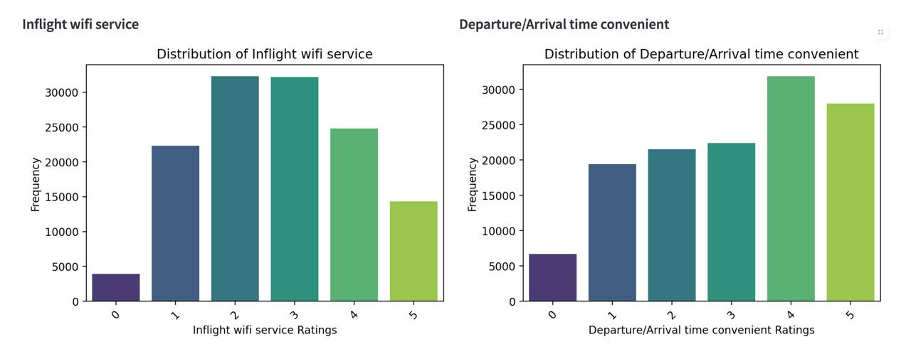

Slide 9
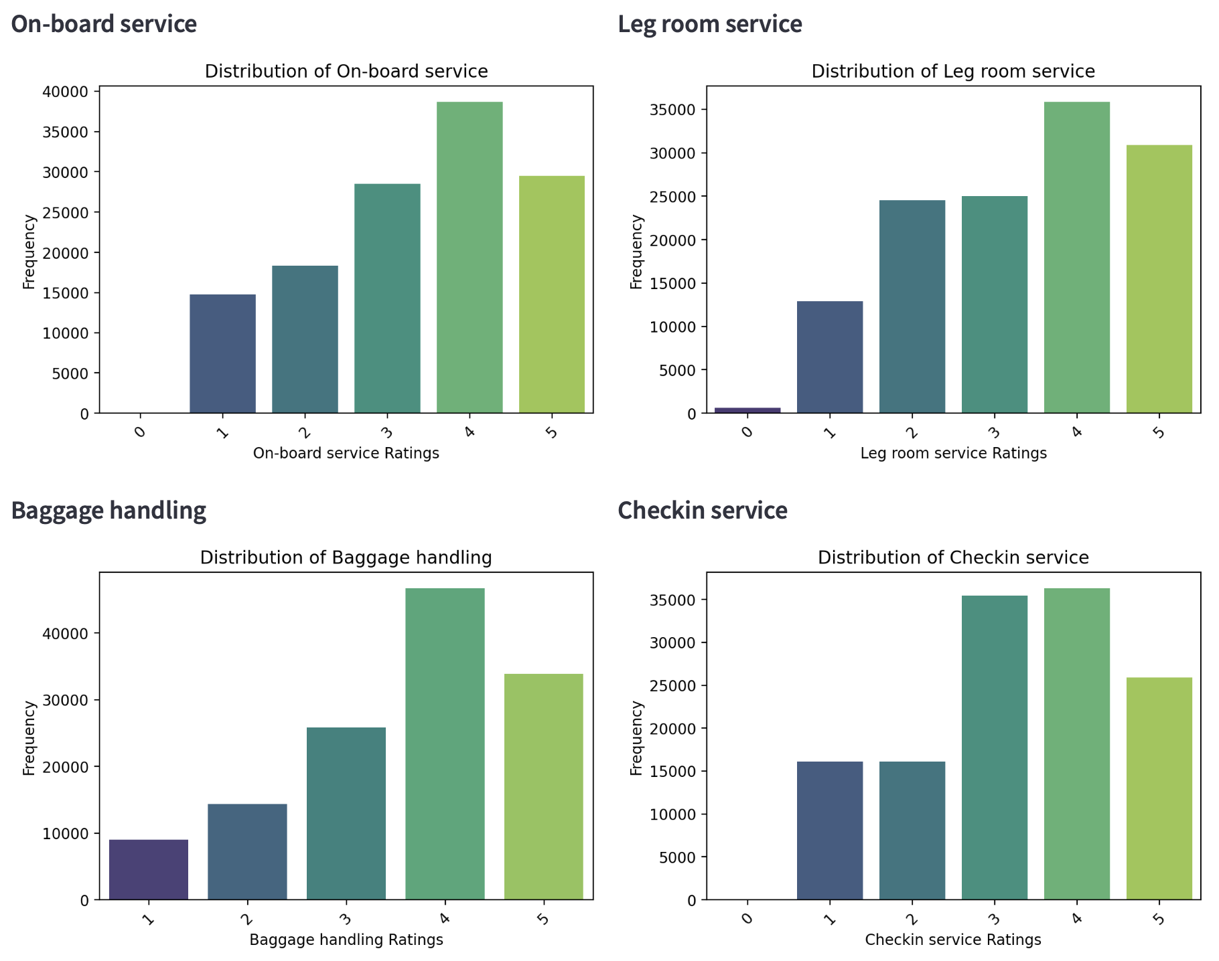
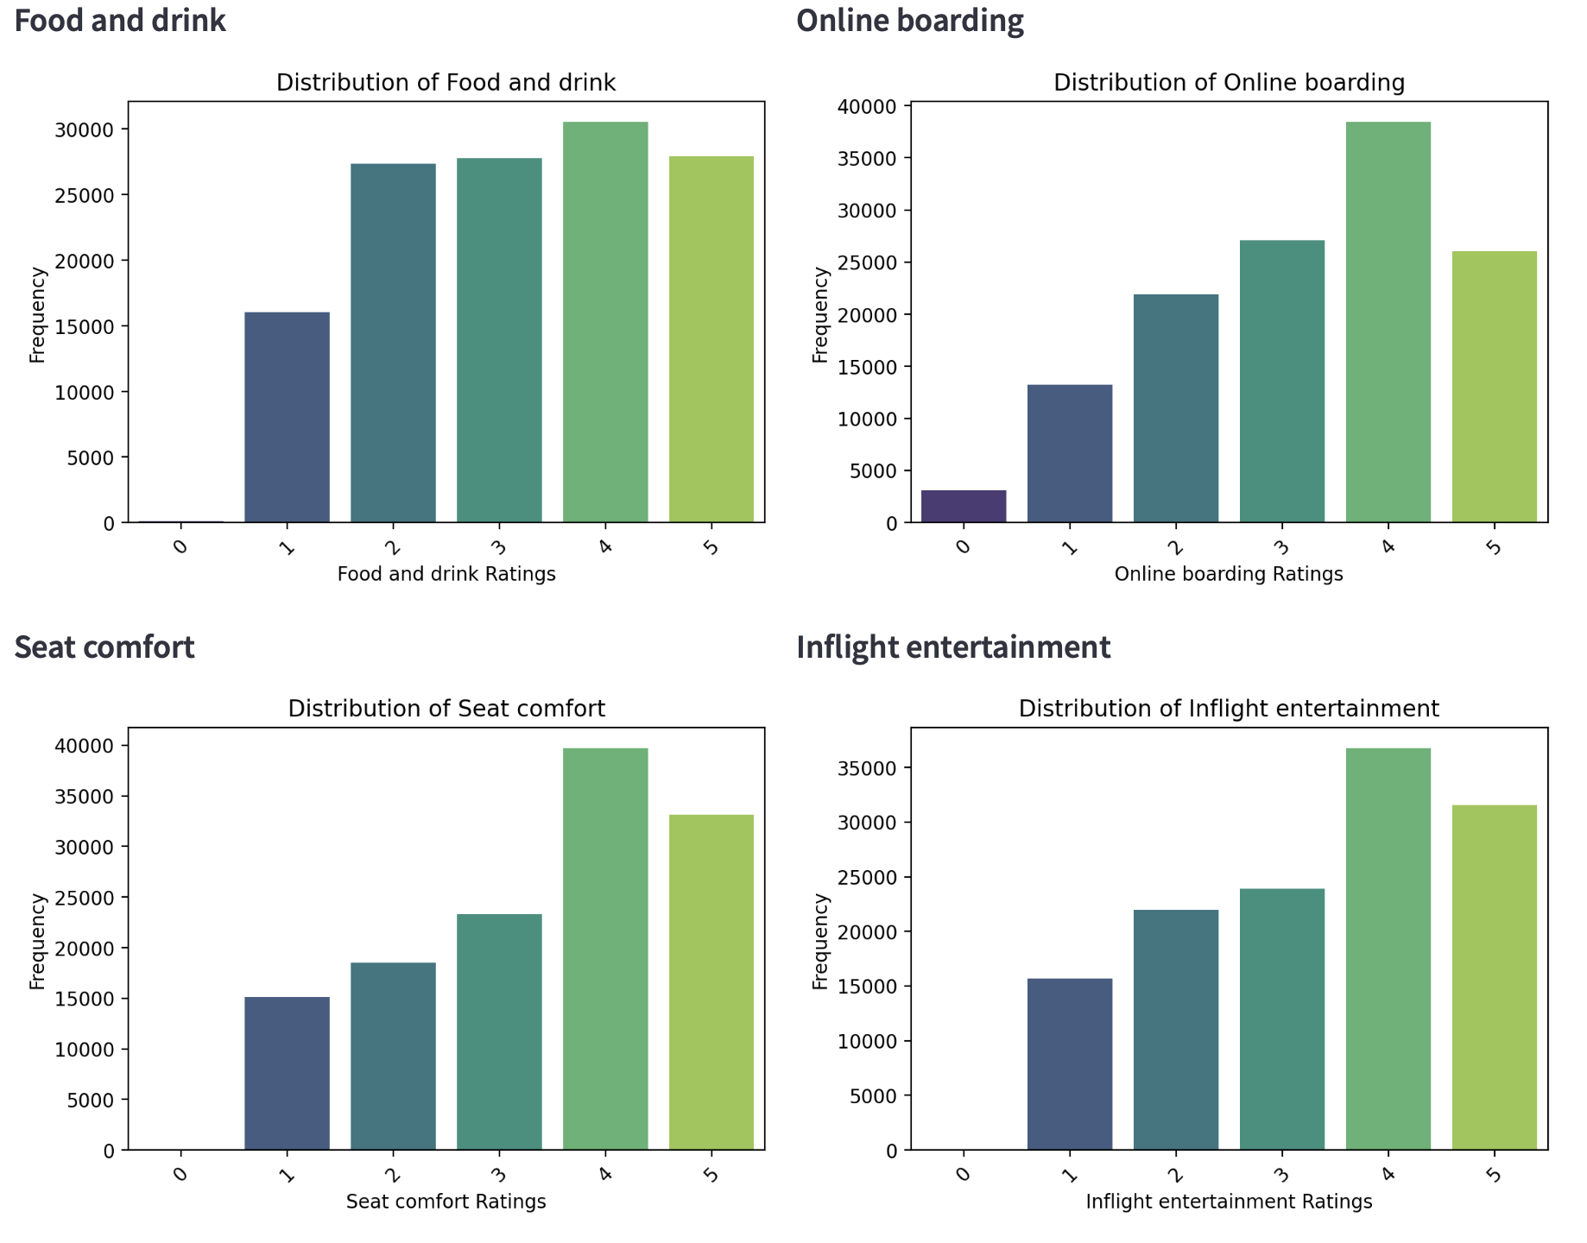

Slide 10
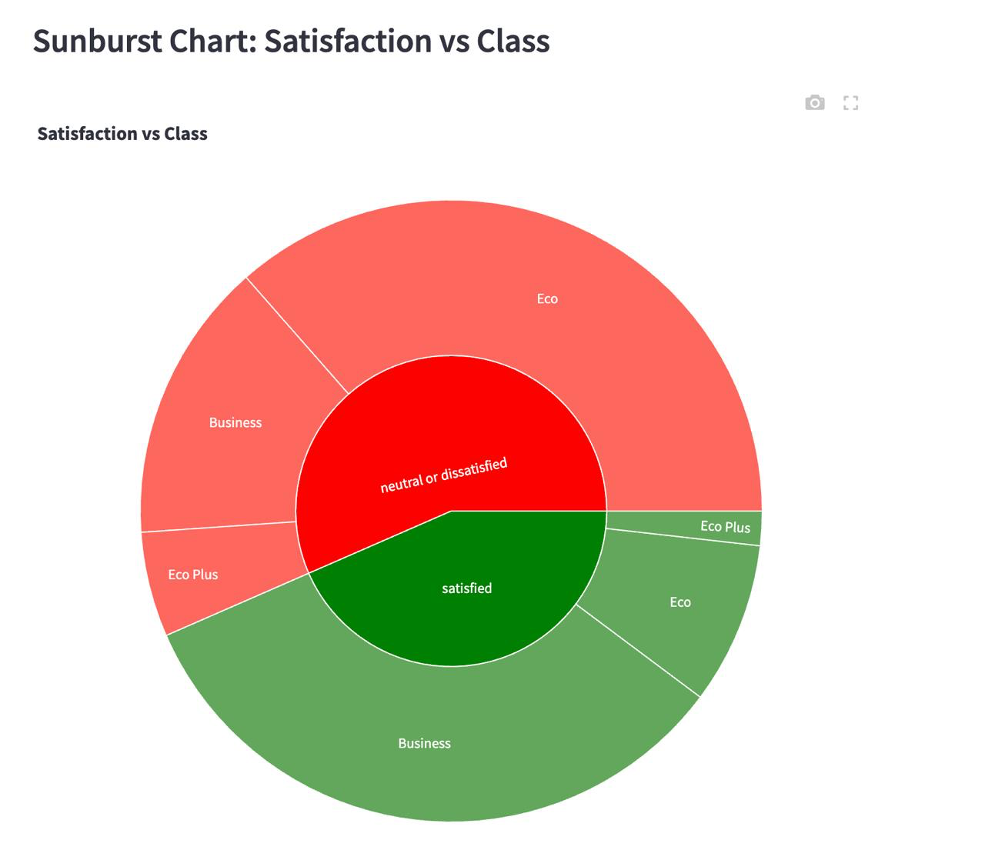
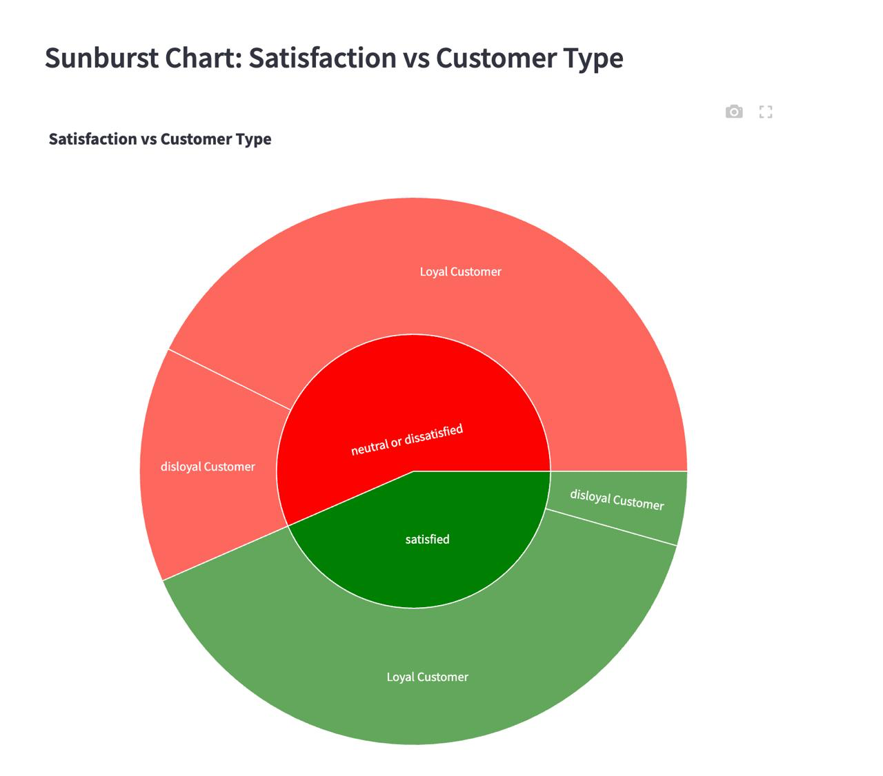
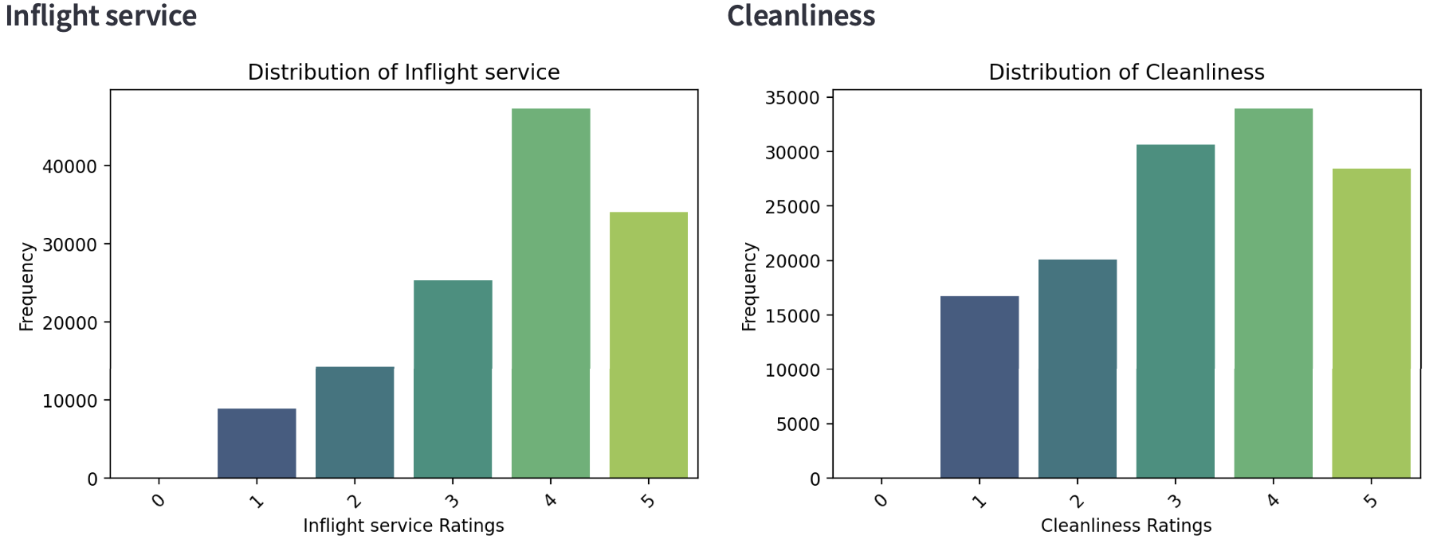
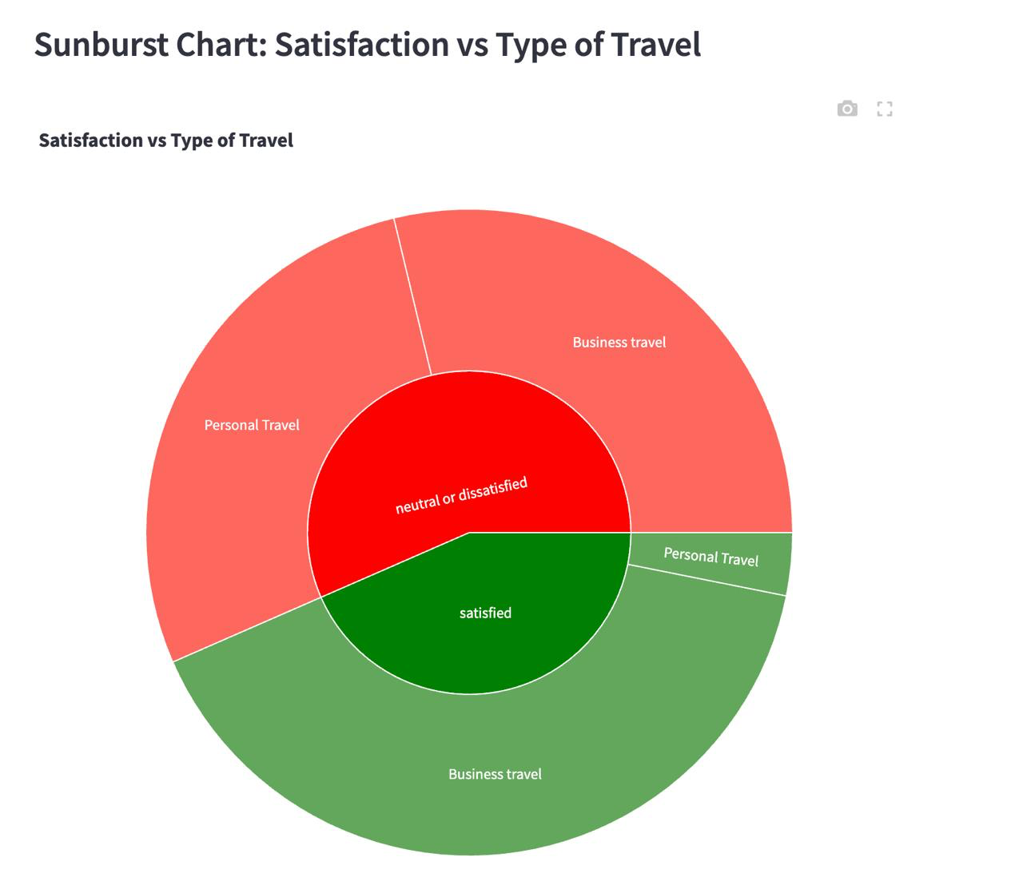
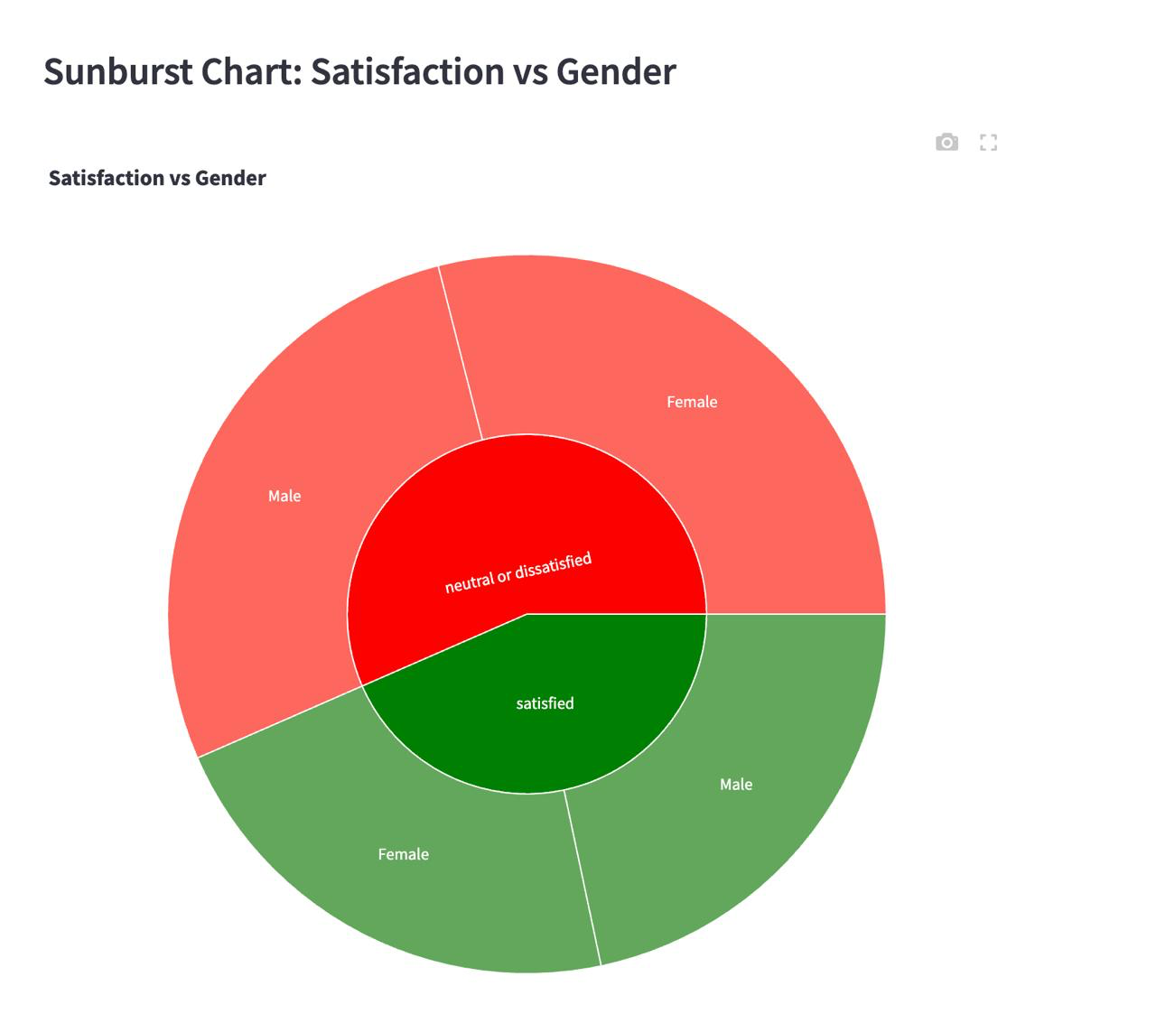
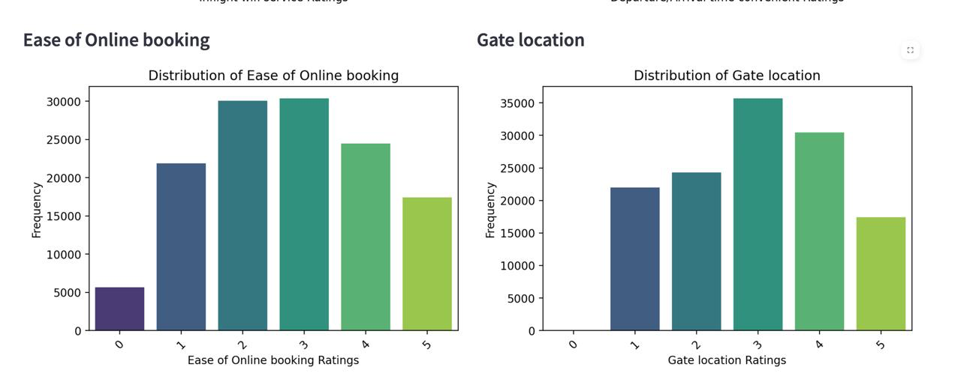

Slide 11
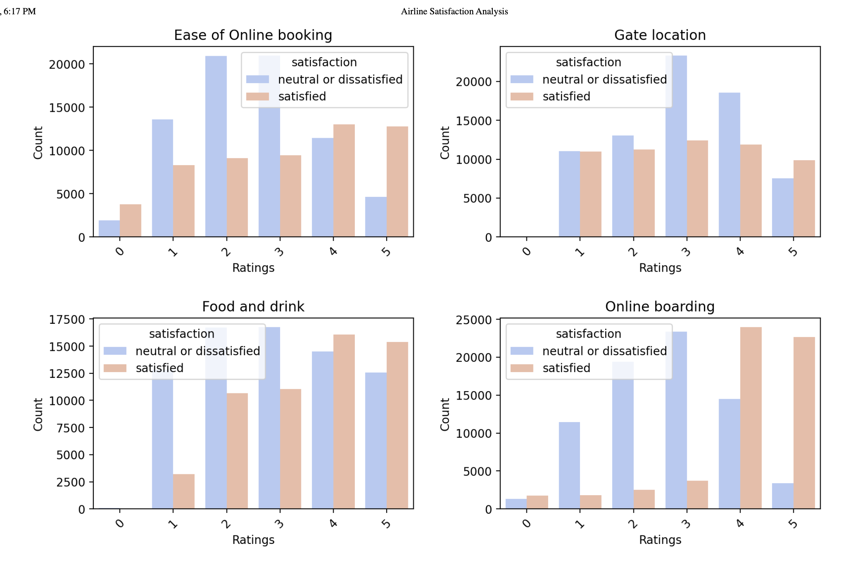
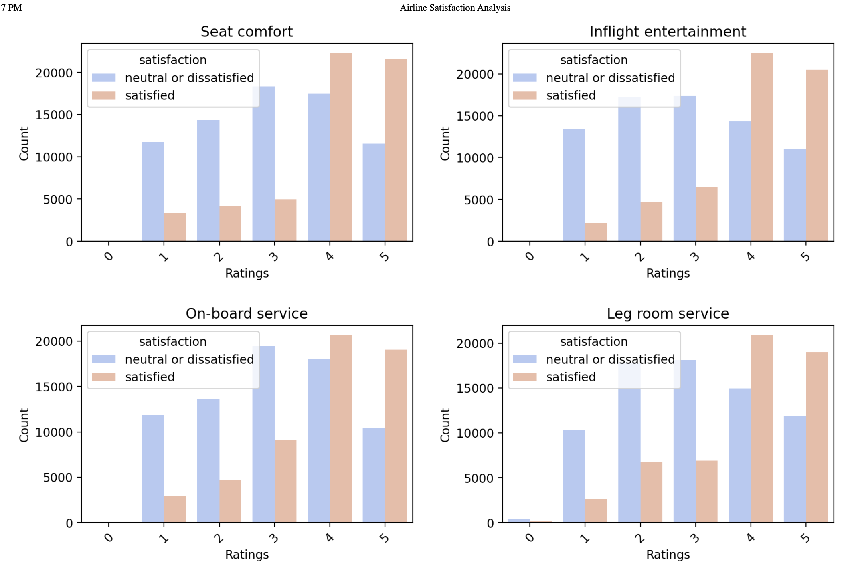

Slide 12
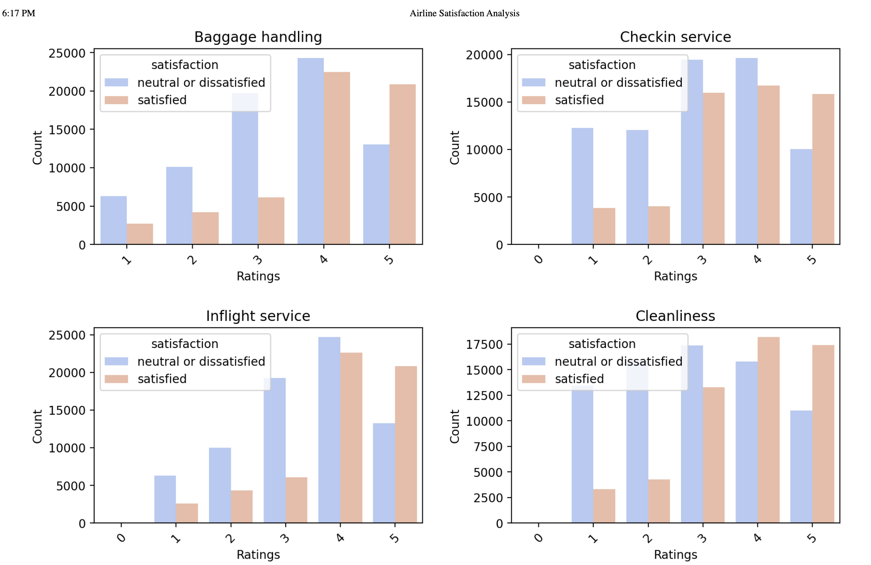

Slide 13
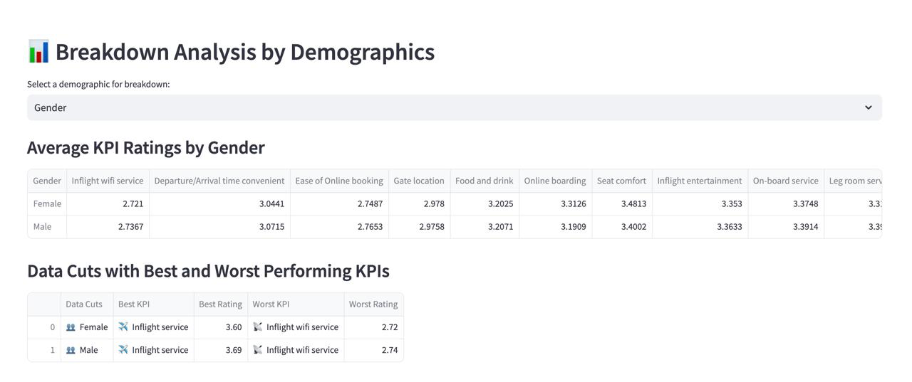
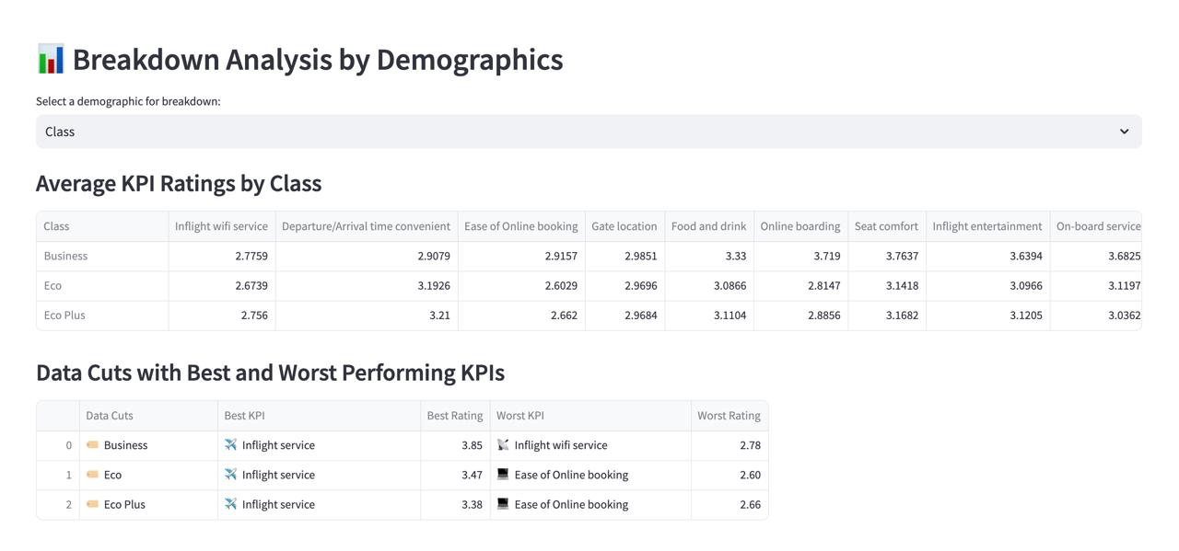
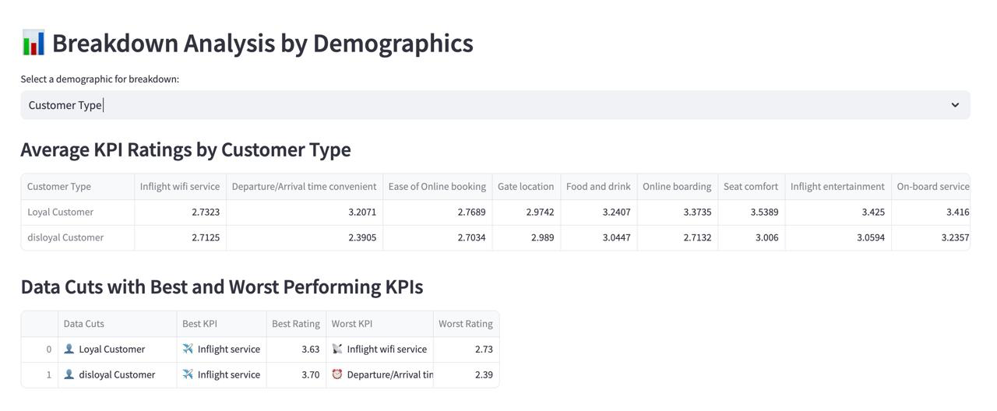
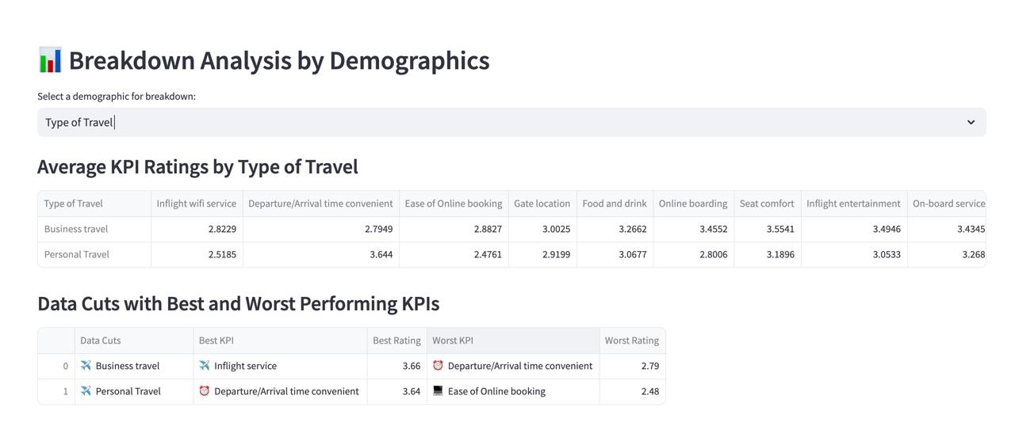

Slide 14
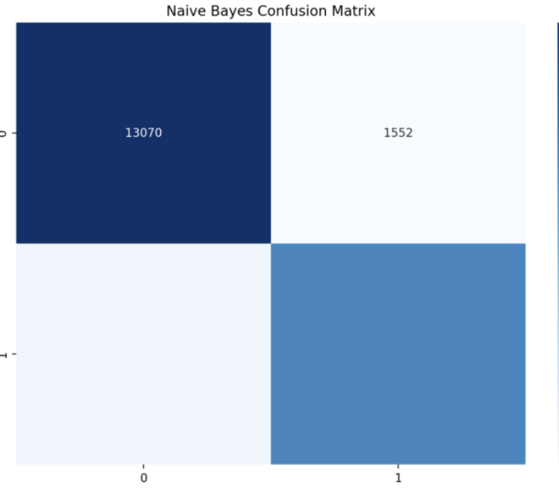
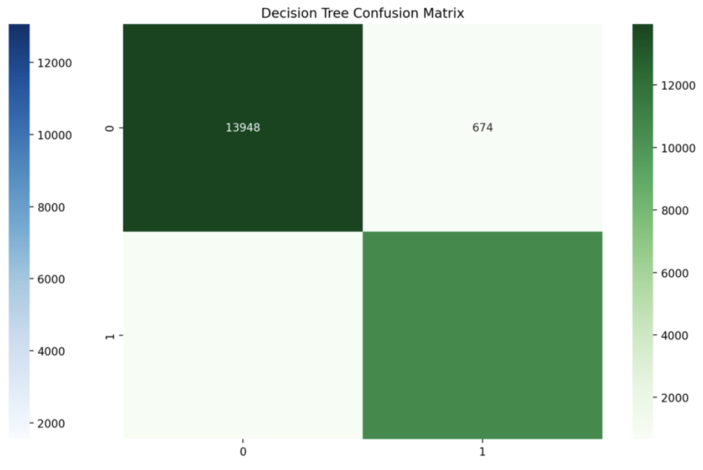
Modeling and Evaluation
Naive Bayes Model
Decision Tree Model
Accuracy: 85.93%
Accuracy: 94.51%
Good performance in predicting customer satisfaction
Outperformed Naive Bayes with higher accuracy
Provides insights into positive and negative outcomes
Better classification of customer satisfaction levels

Slide 15

What are the Most Challenging Parts?
Challenging Part:
Dataset Size Limitation: While performing analysis through the API, there’s a limit on the dataset size that can be processed in real time.
Solution: To overcome this, Power BI was integrated to enable efficient data visualization and improve real-time client accessibility.
Link: Power BI Dashboard Link

Slide 16




Key Recommendations
Enhance Inflight Services
Improve WiFi, entertainment, and legroom to boost satisfaction.
Address Delays Proactively
Enhance scheduling and communication to minimize negative experiences.
Ease of Online Booking
Focus on user-friendly UI.

Slide 17

Thank You

